Slide 1
Fire Extinguishing Team(FET) Briefing
13 Feb 2013

Slide 2
Objectives
To recap the Fire Emergency Procedure/ Plan for the team.
To recap/ update information on Fire Safety in school and the use of Fire-Fighting equipment.
To revisit the Hot Spots in the school.
To brief/ update the programme for Total Defence Day 2013.

Slide 3
Fire Emergency Procedure/ Plan
Objectives:
To prevent panic and ensure the safe, orderly and efficient evacuation of all the occupants in case of a fire emergency.
To get occupants attuned to react rationally when confronted with a fire or other emergency within the premises.
Pre-Fire Drill Actions:
Check all the Fire Extinguishers/ Fire –fighting Equipment are properly maintained and in serviceable condition (Expiry date).
Train/ recap the Fire Extinguishing Team on the use of Fire Extinguishers/ Fire –fighting Equipment.
Check the Fire alarm system.
Fire drill must be held at least once in 6 month.
Approach to allow staff and students to understand the correct procedures to evacuate the buildings in an orderly manner in the min time.
Plans showing the evacuating routes will be explained to all and be prominently displayed at several strategic points in school.
Building Plans for SCDF.
Maintaining written record of the fire drill.

Slide 4
Fire Emergency Procedure/ Plan
Sound of Alarm
Call 995
Roll Call
Fighting Fire
All Clear Signal

Slide 5
Fire Emergency Procedure/ Plan
Calling 995:
Eg. This is Teck Whye Secondary School located at 31 Teck Whye Crescent S(688848), FIRE at the canteen starting at 0900hrs spreading to the rest of the building and there is a casualty at the 2nd store of the canteen with 2nd degree burns.
Evacuation:
Upon detecting fire, SLs/ KPs must be alerted to sound the alarm, the area on fire and its vicinity must also be evacuated immediately.
When the alarms sounds, all occupants must evacuate the premises immediately in a clam and orderly manner, making use of all available except the lift.
Re-entry is forbidden unless permitted by SLs.
School registers must be kept with the office for the Roll Call.
Pupils in each class are to line up in twos and all classes will evacuate simultaneously with priority for access to staircase to be given to higher floors.
Roll Call:
Any pupil/ staff who cannot be accounted for must be reported at once to the SLs together with his/her last known whereabouts in the building.

Slide 6
Fire Emergency Procedure/ Plan
Fighting the Fire:
FET will be mobilized and detailed to proceed to fight the fire from a safe distance with available fire-fighting equipment and attempt to extinguish or control the fire without personal risk pending the arrival of SCDF. (Pupils will not be expected to take an active part in the fire-fighting operation.
All Clear Signal:
SLs will give the All Clear Signal for the re-entry to the building.

Slide 7
FEG members
S/N | Names | Appointment
1 | Mdm Tong Wee Heng | Hd FEG
2 | Mr Christopher Goh | 2 IC FEG
3 | Mr Rahmat | Hd FET 1
4 | Mr Chin Kwek Siong | FET 1 Member
5 | Mr Sulaiman | FET 1 Member
6 | Mr Kumaravel | FET 1 Member
7 | Mr Lee Meng Teck | Hd FET 2
8 | Mr Andrew See | FET 2 Member
9 | Mr Sean Loh | FET 2 Member
10 | Mr Ng Ah Seng | FET 2 Member
11 | Mr Liew Wei Yang | Hd FET 3
12 | Mr Caleb Yap | FET 3 Member
13 | Mr Jordan Loh | FET 3 Member
14 | Mr Mohamed | FET 3 Member

Slide 8
Tasks of FET
FET 1:
Collection of Fire-Fighting Equipment along the way.
Assessing the Fire.
Rescue any casualty and marking of the Casualty point.
Fight the Fire and update Hd FET.
FET 2/ 3:
Collection of Fire-Fighting Equipment.
Assist FEG 1 on the fighting of fire until the arrival of SCDF.

Slide 9
Fire Safety in School
Types of Fire-Fighting Equipment:
Dry Powder Fire Extinguisher and Fire Hydrant.
Hot Spots (To include the location):
Canteen
Laboratory
F&N lab
Location of Fire-Fighting Equipment and evacuation route?

Slide 10
Classification of Fires
Class | Materials | Extinguishing Means
A | Fire involving the burning of ordinary combustible materials e.g. wood, paper, cloth, plastics and rubber. | Carbon dioxide, water and dry powder
B | Fire involving flammable liquids e.g. petrol, solvents, oils, paints, thinner and flammable gases e.g. LPG | Carbon dioxide, dry powder and foam
C | Fire involving live electrical equipment e.g. electrical mains, transformers and electrical appliances. | Carbon dioxide, dry powder
D | Fire involving combustible metals e.g. potassium, magnesium, titanium, sodium, lithium and zirconium | Dry powder

Slide 11
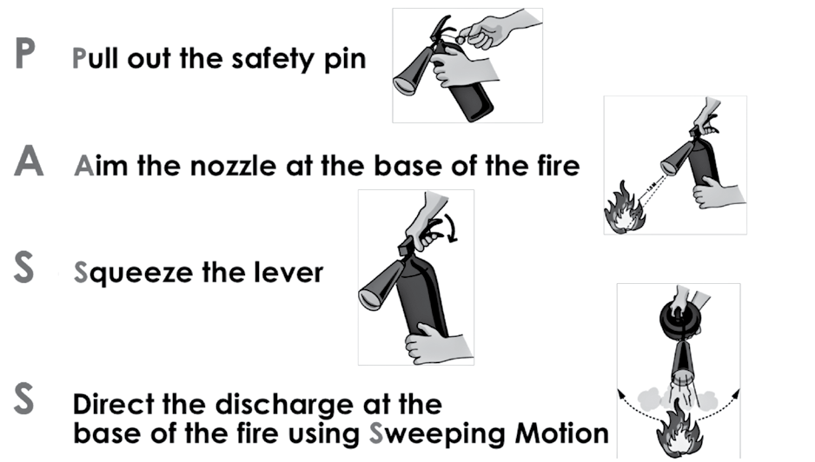
Use of Fire Extinguisher
Do not use water extinguisher for flammable liquid fires and electrical fires.
• For electrical fires, switch off the electrical supply before extinguishing the fire
• If the cookware is on fire, shut off the gas supply without endangering yourself
and smother the fire by using a thick wet cloth to cover the cookware. Do not
pour water into it as the fire will spread

Slide 12
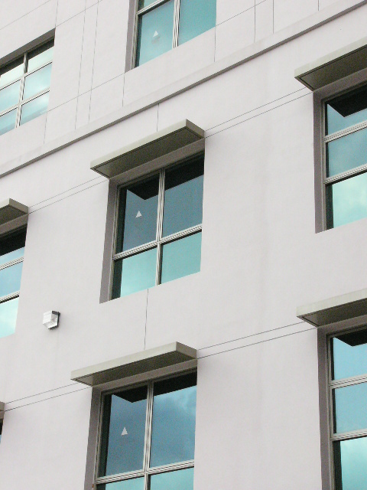
Fire Access Panel
Opening on external wall for external fire-fighting and rescue operation.
Easily opened from inside and outside (fitted with breakable glazing)
Unobstructed at all time
The opening is marked with a red/orange triangle
The minimum size of the opening is 850 mm by 1000 mm

Slide 13
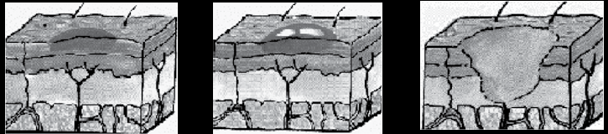
Degree of Burns
1st Degree
Superficial
2nd Degree
Partial Thickness
3rd Degree
Full Thickness
Treatment for burns and scalds
a. Stop the burning process.
b. For chemical burns, wash off the chemicals.
c. Use the four Cs:
Cool the injured part under cold running water or immerse it in cold water for about 10 minutes.
Gently remove any Constrictions such as a bracelet, ring, watch or constricting clothing from the injured area
before it starts to swell.
Cover the injured area to prevent infection. Use clean, preferably sterile, nonadherent material
(e.g. handkerchief, dressing etc.).
Consult the doctor or convey to hospital.
Note
• DO NOT apply toothpaste, lotion, ointment or fat to the injured area
• DO NOT cover the injured area with cotton wool
• DO NOT break any blisters or remove anything that is sticking to the affected
areas

Slide 14
Total Defence Day Programme
Assembly Programme
Fire Drill
Fire extinguishing display (4 fire points at each of the corner of the parade square) at 0920hrs and all prep by 0900hrs.

